Slide 1
Delivery, Forwarding, and Routing of IP Packets

Slide 2
Delivery, Forwarding, and Routing of IP Packets
Objectives
Upon completion you will be able to:
Understand the different types of delivery and the connection
Understand forwarding techniques in classful addressing
Understand forwarding techniques in classless addressing
Understand how a routing table works

Slide 3
6.1 DELIVERY
The network layer supervises the handling of the packets by the underlying physical networks.
Two important concepts are the type of connection and direct versus indirect delivery.
Notes:
The delivery of a packet to its final destination is accomplished by using two different methods of delivery, direct and indirect

Slide 4
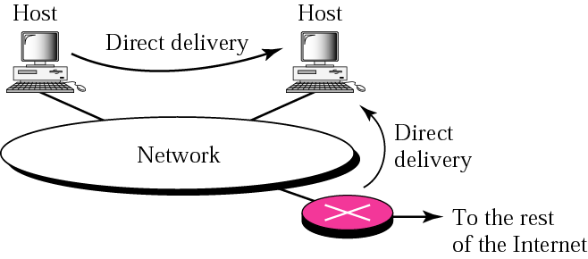
Figure 6.1 Direct delivery
How to determine that Destination in the same network?
(Destination IP) AND (Corresponding Mask) = Network Address of the Network
ARP finds Physical address of Destination.
Information is passed to Data Link Layer.
Notes:
2 different methods of delivery
The sender can easily determine if the delivery is direct. It can extract the network
address of the destination (using the mask) and compare this address with the addresses
of the networks to which it is connected. If a match is found, the delivery is direct.
In direct delivery, the sender uses the destination IP address to find the destination
physical address. The IP software then gives the destination IP address with the destination
physical address to the data link layer for actual delivery. This process is called
mapping the IP address to the physical address. Although this mapping can be done by
finding a match in a table, we will see in Chapter 8 that a protocol called Address Resolution Protocol (ARP) dynamically maps an IP address to the corresponding physical address.
address.

Slide 5
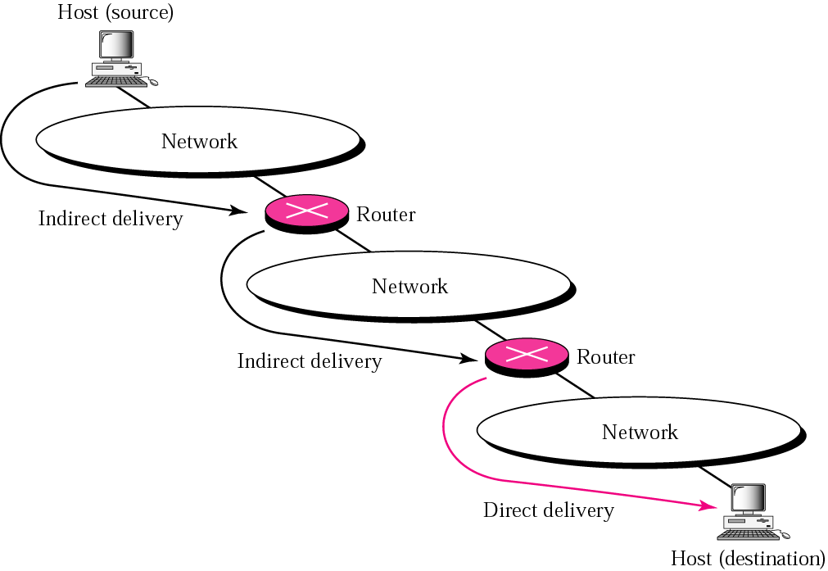
Figure 6.2 Indirect delivery
Mapping is between the IP address of the next router and the physical
address of the next router.
In an indirect delivery,
the device that receives the packet is
Not destination but intermediate device
Notes:
Next hop can be the final destination or the intermediate connecting device
In an indirect delivery, the sender uses the destination IP address and a routing
table to find the IP address of the next router to which the packet should be delivered.
The sender then uses ARP (see Chapter 8) to find the physical address of the next
router. Note that in direct delivery, the address mapping is between the IP address of the
final destination and the physical address of the final destination. In an indirect delivery,
the address mapping is between the IP address of the next router and the physical
address of the next router. Note that a delivery always involves one direct delivery but
zero or more indirect deliveries. Note also that the last delivery is always a direct delivery.

Slide 6
6.2 FORWARDING
Forwarding means to place the packet in its route to its destination.
Means- Deliver the packet to the Next hop.
Forwarding requires a host or a router to have a routing table.
Routing refers to the creation and maintenance(updating) of routing tables
The topics discussed in this section include:
Forwarding Techniques
-based on Destination Address
-based on Label (not discussed)
Forwarding with Classful Addressing
Forwarding with Classless Addressing
Combination
Notes:
Forwarding means to place the packet in its route to its destination. Since the Internet
today is made of a combination of links (networks), forwarding means to deliver the
packet to the next hop.

Slide 7
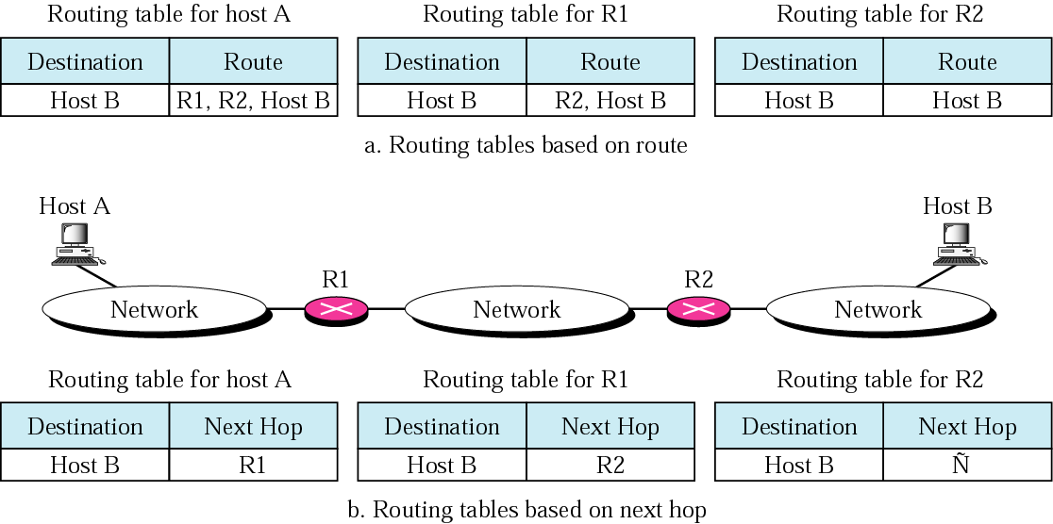
Figure 6.3 Based on Route & Next-hop method
Routing table based on Complete route Information
Routing table based on Next Hop
Which is Better?
An entry for every destination host connected to the same physical network(where B connected). If 1000 hosts in a network ,means 1000 entries in routing table
Notes:
Which is Better?
Next-Hop Method One technique to reduce the contents of a routing table is called
the next-hop method. In this technique, the routing table holds only the address of the
next hop instead of information about the complete route.

Slide 8
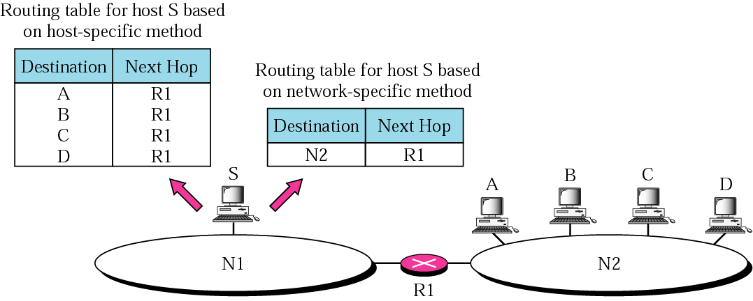
Figure 6.4 Network-specific method & host-specific method
Host-specific
Network-specific
Here efficiency is sacrificed for other advantages
Network-specific Only one entry that every network the address of the destination network. Treat all hosts connected to the same network as one single entity
Notes:
Network-specific :
Here we have only one entry that defines the address of the destination network itself, rather than an entry for every host in the network
In other words, we treat all hosts connected to the same network as one single entity. For example,
if 1000 hosts are attached to the same network, only one entry exists in the routing
table instead of 1000. Figure 6.4 shows the concept.
In the host-specific method, the destination host address is
given in the routing table. The rationale behind this method is the inverse of the
network-specific method. Here efficiency is sacrificed for other advantages: Although
it is not efficient to put the host address in the routing table, there are occasions in
which the administrator wants to have more control over routing. For example, in
Figure 6.5 (Next slide)if the administrator wants all packets arriving for host B delivered to
router R3 instead of R1,

Slide 9
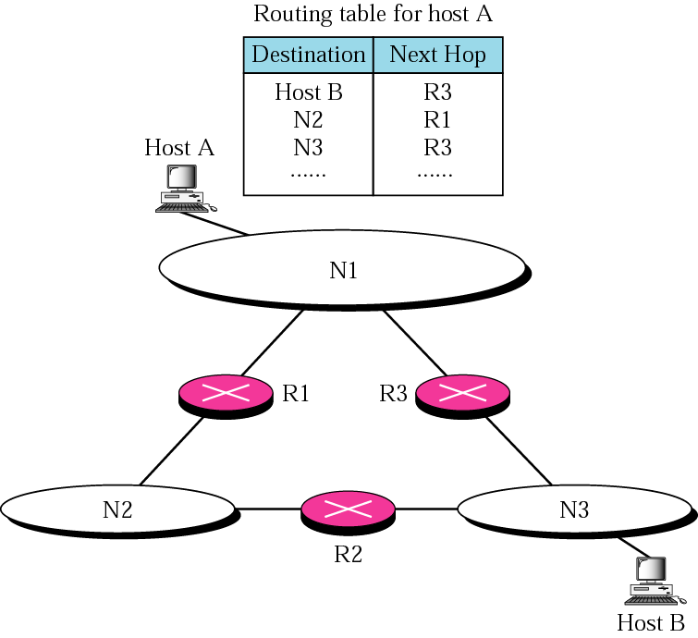
Figure 6.5 Host-specific routing
In some occasions where the administrator wants to have more control over routing.
Notes:
.In Host Specific- Here efficiency is sacrificed for other advantages: Although
it is not efficient to put the host address in the routing table, there are occasions in
which the administrator wants to have more control over routing. For example, in
Figure 6.5 if the administrator wants all packets arriving for host B delivered to
router R3 instead of R1,

Slide 10
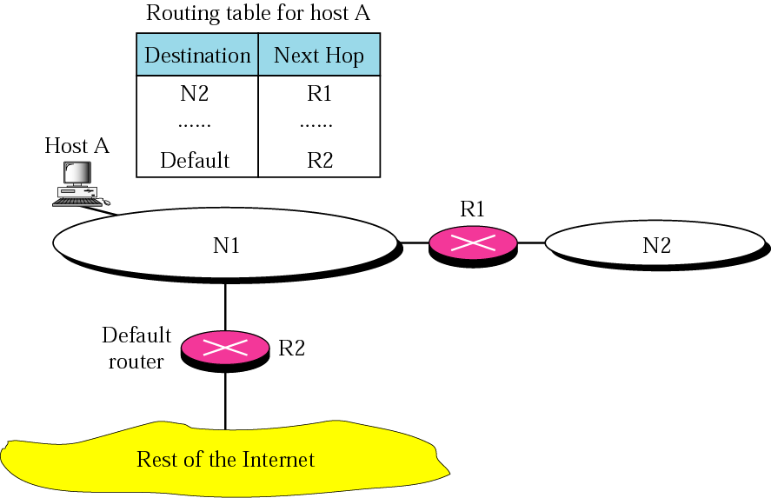
Figure 6.6 Default routing
one entry called the default (normally defined as network address 0.0.0.0 last entry in table)
Notes:
Default Method Another technique to simplify routing is called the default method.
In Figure 6.6 host A is connected to a network with two routers. Router R1 routes the
packets to hosts connected to network N2. However, for the rest of the Internet, router
R2 is used. So instead of listing all networks in the entire Internet, host A can just have
one entry called the default (normally defined as network address 0.0.0.0).
Do not confuse with All-Zeros Address
he block 0.0.0.0/32 given in page 147 under special addresses. In special addresses 0.0.0.0 is used as source address by a host ,when it doesn't know own IP(to get IP from BOOTP/DHCP server).
In routing table it is as a Subnet address. Router always looks for Destination IP to find network/subnet address., so no packet will contain destination IP 0.0.0.0 ., hence no conflict between if Source IP is 0.0.0.0.

Slide 11
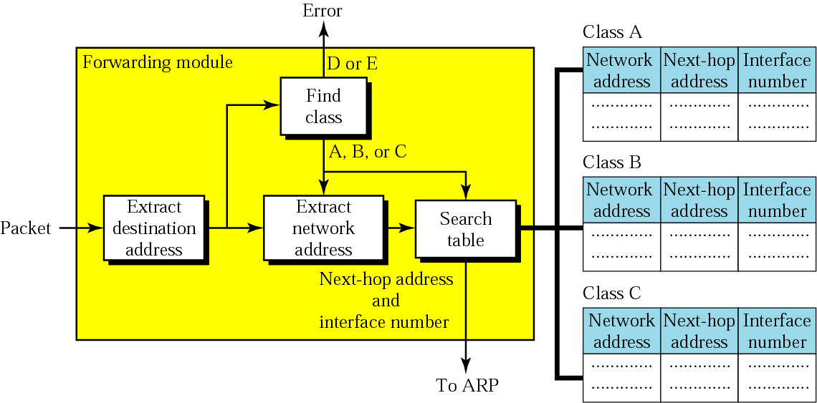
Forwarding with Classful Addressing
Figure 6.7 Simplified forwarding module in classful address without
subnetting
Based on Network Specific Forwarding
Class identified by shifting the copy of the Destination address 28 bits to the right
Notes:
Let us see – How Routing Table will be?
Based on Network Specific Forwarding
Which table to search (Search Table Component) is based on class information received from “Find Class” component.
In its simplest form, the forwarding module follows these steps:
1. The destination address of the packet is extracted.
2. A copy of the destination address is used to find the class of the address. This is done by shifting the copy of the Destination address 28 bits to the right. The result is a 4-bit ,number between 0 and 15. If the result is
a. 0 to 7, the class is A.
b. 8 to 11, the class is B.
c. 12 or 13, the class is C
d. 14, the class is D.
e. 15, the class is E.
3. The result of Step 2 for class A, B, or C and the destination address are used to
extract the network address. This is done by masking off (changing to 0s) the rightmost
8, 16, or 24 bits based on the class.
4. The class of the address and the network address are used to find next-hop information.
The class determines which table is to be searched. The module searches
this table for the network address. If a match is found, the next-hop address and
the interface number of the output port are extracted from the table. If no match is
found, the default is used.
5. The ARP module (Chapter 8) uses the next-hop address and the interface number
to find the physical address of the next router. It then asks the data link layer to
deliver the packet to the next hop.
Class Byte-1 Byte-2 Byte-3 Byte-4 28 bit right sift Value after R-Shift
A 00000000 00000000 00000000 00000000 0000 0
01111111 11111111 11111111 11111111 0111 7
B 10000000 00000000 00000000 00000000 1000 8
10111111 11111111 11111111 11111111 1011 11
C 11000000 00000000 00000000 00000000 1100 12
11011111 11111111 11111111 11111111 1101 13
D 11100000 00000000 00000000 00000000 1110 14
11101111 11111111 11111111 11111111 1110 14
E 11110000 00000000 00000000 00000000 1111 15
11111111 11111111 11111111 11111111 1111 15

Slide 12
Identifying IP class by 28-bit right Shifting
Class | Staring Bits | Octet-1 Lower Bound | Octet-1 Upper Bound | Byte-1 Lower Bound | Byte-1 Upper Bound | Range after 28 bit right shit
A | 0… | 00000000 | 01111111 | 0 | 127 | 0 to 7
B | 10… | 10000000 | 10111111 | 128 | 191 | 8 to 11
C | 110.. | 11000000 | 11011111 | 192 | 223 | 12 to 13
D | 1110.. | 11100000 | 11101111 | 224 | 239 | 14
E | 1111… | 11110000 | 11111111 | 240 | 255 | 15
120.100.100.10
0111 1000 0110 0100 0110 0100 0000 1010
Result of 28 bit right-shift
0000 0000 0000 0000 0000 0000 0000 0111 = 7
Notes:
Example : 120.100.100.10
Result of 28 bit right-shift
Identifying IP class by 28-bit right Shifting

Slide 13
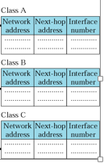
Example 1 :Forwarding with Classful Addressing
Figure 6.8 shows an imaginary part of the Internet. Show the routing tables for router R1.
See Next Slide
For reference-Simple Routing Table Structure
Notes:
Simple Routing Table Structure

Slide 14
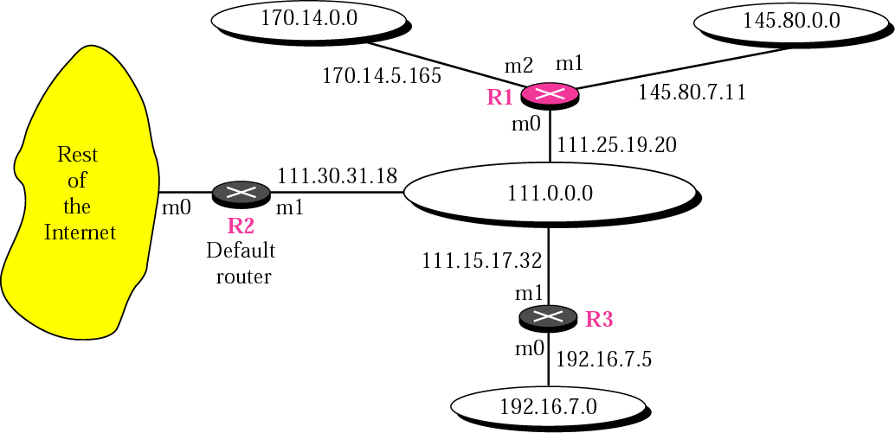
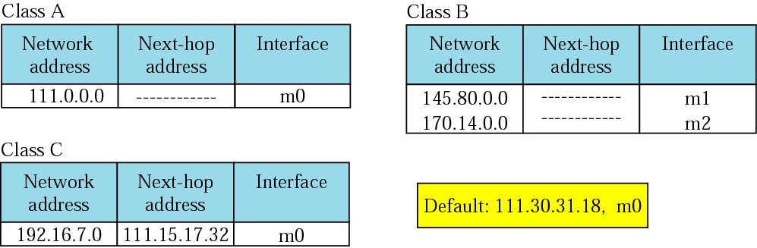
Figure 6.8 Configuration for routing, Example 1
Class B
Class B
class A
Class C
Separate Table for Each of classes A,B ,C
Notes:
Separate Table for each of classes A,B ,C
Default routing entry
Network Address Next-hop Address Interface
Default(0.0.0.0) 111.30.31.18 m0

Slide 15
Figure 6.9 Tables for Example 1
Some next-hop address column are empty because in these cases, the destination is in the same network to which the router is connected (direct delivery)
Notes:
Network address is Default means it is 0.0.0.0 ( not this can be only Destination address –unlike in case of special addresses all zeros 0.0.0.0/32 used as source address only during bootstrap)

Slide 16
Example 1 (Continued)
Note:
Figure 6.9 shows the three tables used by router R1. Note that some entries in the next-hop address column are empty because in these cases, the destination is in the same network to which the router is connected (direct delivery). In these cases, the next-hop address used by ARP is simply the destination address of the packet to find MAC address of destination.
See Next Slide

Slide 17
Example 2
Router R1 in Figure 6.8 receives a packet with destination address 192.16.7.14. Show how the packet is forwarded (referring Routing Table in Figure 6.9) .
Solution The destination address in binary is 11000000 00010000 00000111 00001110. A copy of the address is shifted 28 bits to the right.
The result is 00000000 00000000 00000000 00001100 or 12.
The destination network is class C.
The network address is 192.16.7.0. The table for Class C is searched. The network address is found in the first row. The next-hop address 111.15.17.32. and the interface m0 are passed to ARP.
Notes:
To identify class –leftmost 4 bits needed.
Doing 28 bit right shift ,brings ,leftmost 4 bits to Right most end. Convert right most 4 bit values to Decimal value lies 0-15 and we can categorize class as below-
a. 0 to 7, the class is A.
b. 8 to 11, the class is B.
c. 12 or 13, the class is C
Note:
Class: A Starts 0 0000- 0111 0 to 7
Class: B Starts 10 1000- 1011 8 to 11
Class: C Starts 110 1100- 1101 12 to 13
Class: D Starts 1110 1110 14
Class: E Starts 1111 1111 15
The network address is extracted by masking off the leftmost 24 bits of the destination address; the result is 192.16.7.0.

Slide 18
Example 3
Router R1 in Figure 6.8 receives a packet with destination address 167.24.160.5. Show how the packet is forwarded.
Solution
The destination address in binary is 10100111 00011000 10100000 00000101.
A copy of the address is shifted 28 bits to the right. The result is 00000000 00000000 00000000 00001010 or 10.
The class is B is searched.
The network address is 167.24.0.0. The table for Class B is searched. No matching network address is found. The packet needs to be forwarded to the default router (the network is somewhere else in the Internet). The next-hop address 111.30.31.18 and the interface number m0 are passed to ARP.
Notes:
The network address can be found by masking off 16 bits of the destination address, the result is 167.24.0.0.

Slide 19
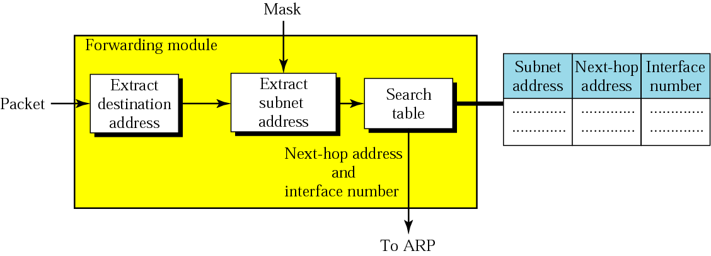
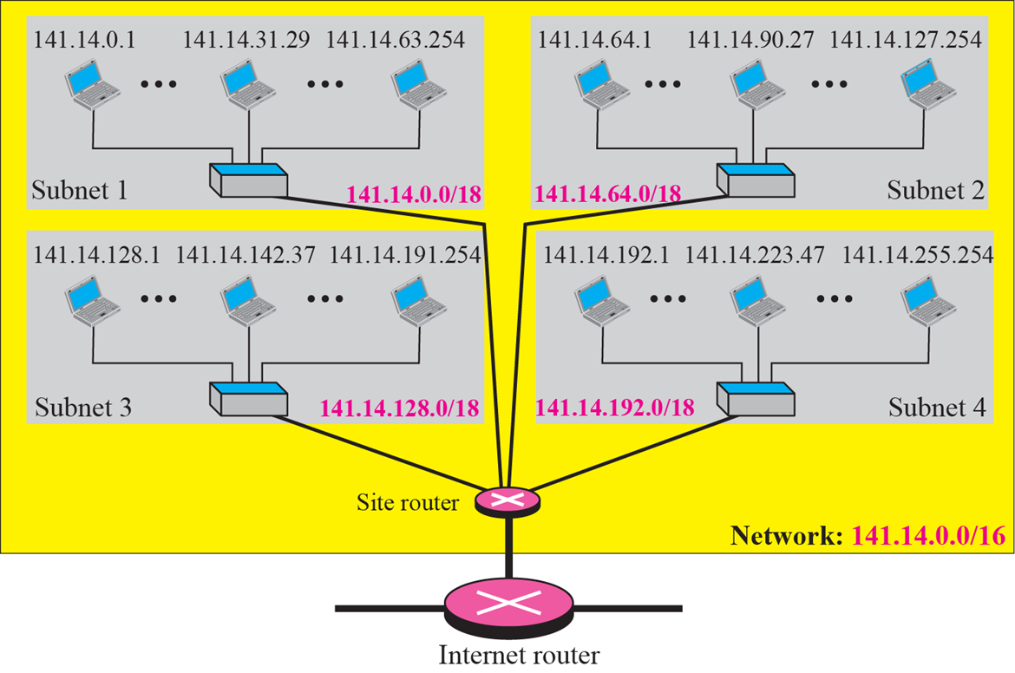
Figure 6.10 Simplified forwarding module in classful address with subnetting
Site router-Routing Table
Notes:
Site router-Table
Figure 6.10 shows a
simplified module for fixed-length subnetting.
1. The module extracts the destination address of the packet.
2. If the destination address matches any of the host-specific addresses in the table,
the next-hop and the interface number is extracted from the table.
3. The destination address and the mask are used to extract the subnet address.
4. The table is searched using the subnet address to find the next-hop address and the
interface number. If no match is found, the default is used.
5. The next-hop address and the interface number are given to ARP (see Chapter 8).

Slide 20
Example 4
Figure 6.11 shows a router connected to four subnets.
See Next Slide

Slide 21
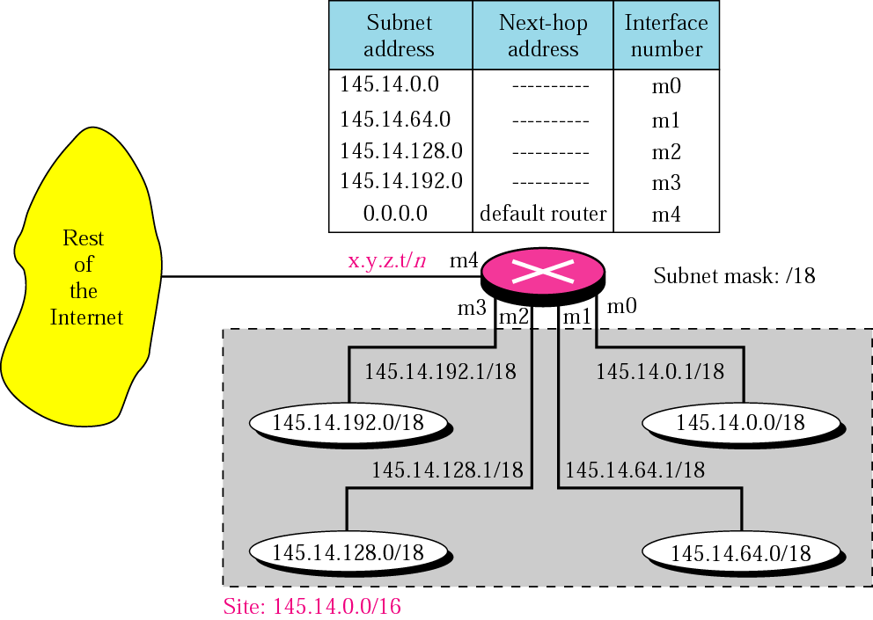
Figure 6.11 Configuration for Example 4
145.14.0.0/16
Notes:
145.14.0.0/18
Explanation about network

Slide 22
Example 4 (Continued)
Note several points. First, the site address is 145.14.0.0/16 (a class B address).
Every packet with destination address in the range 145.14.0.0 to 145.14.255.255 is delivered to the interface m4 and distributed to the final destination subnet by the router.
Second, we have used the address x.y.z.t/n for the interface m4 because we do not know to which network this router is connected.
Third, the table has a default entry for packets that are to be sent out of the site. The router is configured to apply the mask /18 to any destination address.
Notes:
/18 means, the Subnet mask is 255.255.192.0
Any address in the range (145.14.0.0 to 145.14.255.255) AND SubNet Mask = Subnet Address.
Search Subnet Address in the Routing Table & Forward to corresponding Interface.

Slide 23
Example 5
The router in Figure 6.11 receives a packet with destination address 145.14.32.78. Show how the packet is forwarded.
Solution The mask is(255.255.192.0) for prefix /18. After applying the mask, the subnet address is 145.14.0.0. The packet is delivered to ARP with the next-hop address 145.14.32.78(Direct-Delivery) and the outgoing interface m0.
Notes:
Next hop address is Destination address itself, because it is direct delivery ,i.e. there is no next hop the destination is in the same network

Slide 24
Example 6
A host in network 145.14.0.0 in Figure 6.11 has a packet to send to the host with address 7.22.67.91. Show how the packet is routed.
Solution The router receives the packet and applies the mask (255.255.192.0) for prefix (/18). The network address is 7.22.64.0. The table is searched and the address is not found. The router uses the address of the default router (not shown in figure) and sends the packet to that router.
Notes:
Delivering to host outside network using Default Router

Slide 25
Note:
In classful addressing we can have a routing table with three columns;
in classless addressing, we need at least four columns.

Slide 26
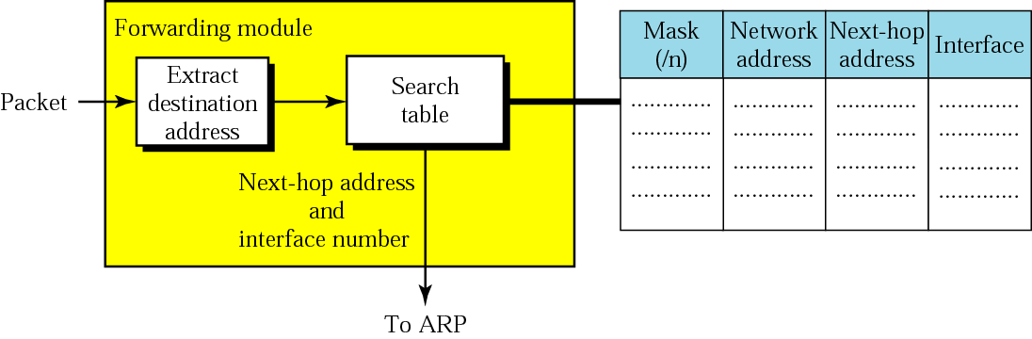
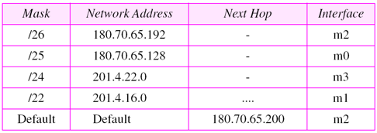
Figure 6.12 Simplified forwarding module in classless address
Note: /n is required in the Table
Network address extraction is done at the same time as table searching
Example:
Notes:
Figure 6.12 shows a simple forwarding module for classless addressing. Note that
network address extraction is done at the same time as table searching because there is
no inherent information in the destination address that can be used for network address
extraction.
Example:

Slide 27
Example 7
Make a routing table for router R1 using the configuration in Figure 6.13.
See Next Slide
Solution Table 6.1 shows the corresponding table.
See the table after the figure.

Slide 28
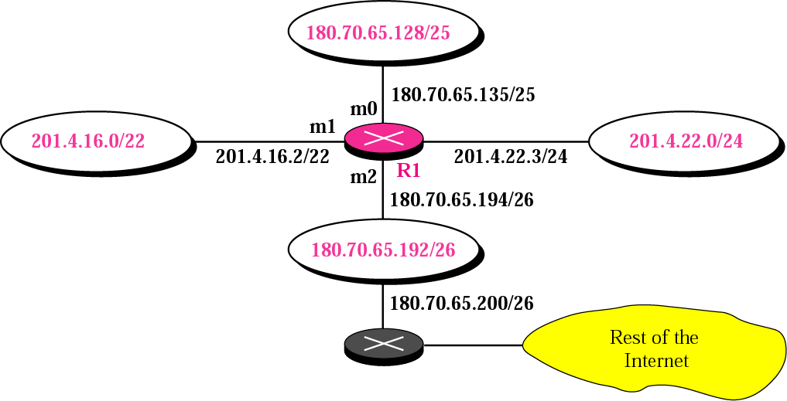
Figure 6.13 Configuration for Example 7
Default Router
Notes:
Default Router

Slide 29
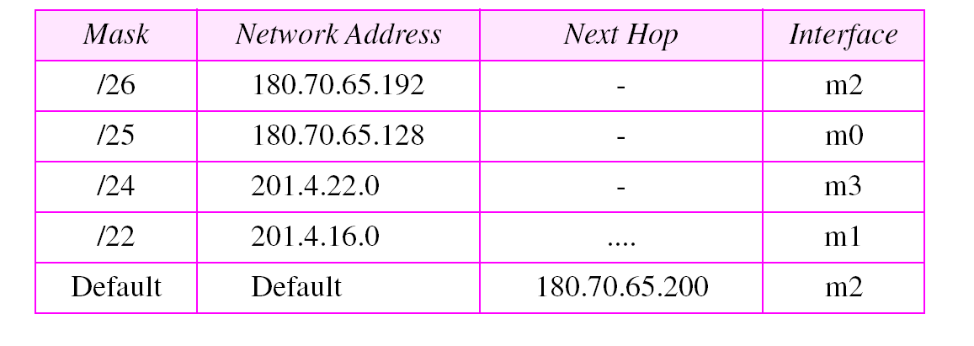
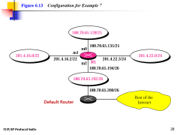
Table 6.1 Routing table for router R1 in Figure 6.13

Slide 30

Example 8
Show the forwarding process if a packet arrives at R1 in Figure 6.13 with the destination address 180.70.65.140.
Solution The router performs the following steps:
The first mask (/26) is applied to the destination address.
The result is 180.70.65.128, which does not match the corresponding network address.
180.70.65.140 AND 255.255.255.192 gives 180.70.65.128 is the Network Address
Notes:
Annimation is used, please run slide show to view in sequence
26 means the Mask is 255.255.255.192/26
180.70.65.140
AND 255.255.255.192
==============
180.70.65.128 is the Network Address

Slide 31
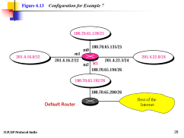
Example 8 (Continued)
2. The second mask (/25) is applied to the destination address.
The result is 180.70.65.128, which matches the corresponding network address. The next-hop address (the destination address of the packet in this case) and the interface number m0 are passed to ARP for further processing.
180.70.65.140 AND 255.255.255.128 gives 180.70.65.128 is the Network Address

Slide 32

Example 9
Show the forwarding process if a packet arrives at R1 in Figure 6.13 with the destination address 201.4.22.35.
Solution The router performs the following steps:
Table 6.1 Routing table for router R1 in Figure 6.13

Slide 33
Example 9 (Continued)
1. The first mask (/26) is applied to the destination address. The result is 201.4.22.0, which does not match the corresponding network address (row 1).
2. The second mask (/25) is applied to the destination address. The result is 201.4.22.0, which does not match the corresponding network address (row 2).
3. The third mask (/24) is applied to the destination address. The result is 201.4.22.0, which matches the corresponding network address. The destination address of the package and the interface number m3 are passed to ARP.
Notes:
/26 means the Mask is 255.255.255.192/26
201.4.22.35
AND 255.255.255.192
==============
201.4.22.0 is the Network Address

Slide 34
Example 10
Show the forwarding process if a packet arrives at R1 in Figure 6.13 with the destination address 18.24.32.78.
Solution This time all masks are applied to the destination address, but no matching network address is found. When it reaches the end of the table, the module gives the next-hop address 180.70.65.200 and interface number m2 to ARP. This is probably an outgoing package that needs to be sent, via the default router, to some place else in the Internet.

Slide 35
Example 11
Now let us give a different type of example. Can we find the configuration of a router, if we know only its routing table? The routing table for router R1 is given in Table 6.2. Can we draw its topology?
See Next Slide

Slide 36
Routing table for Example 11
Draw he Topology Corresponding to following routing Table
Mask | Network Address | Next hop Address | Interface Number
/24 | 192.16.7.0 | 111.15.17.32 | m0
/16 | 145.80.0.0 | -------------- | m1
/16 | 170.14.0.0 | -------------- | m2
/8 | 111.0.0.0 | -------------- | m0
default | default | 111.30.31.18 | m0
Notes:
Draw he Topology Corresponding to following routing Table

Slide 37
Figure 6.8 Configuration for routing, Example 1

Slide 38
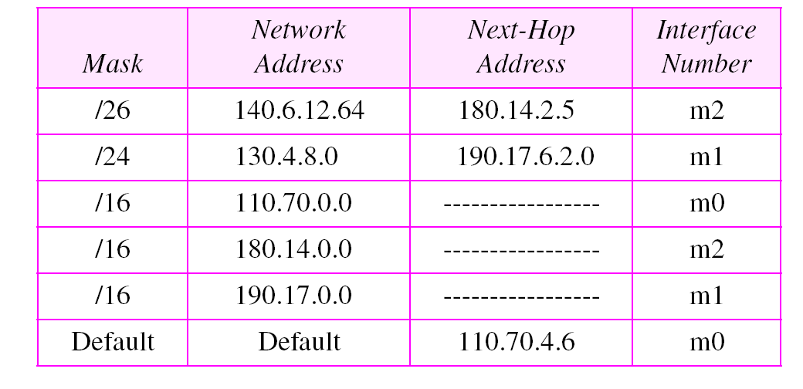
Draw he Topology Corresponding to following routing Table
Table 6.2 Routing table for Example 11

Slide 39
Example 11
(Continued)
Solution We know some facts but we don’t have all for a definite topology.
We know that router R1 has three interfaces: m0, m1, and m2.
We know that there are three networks directly connected to router R1.
We know that there are two networks indirectly connected to R1.
There must be at least three other routers involved (see next-hop column). We know to which networks these routers are connected by looking at their IP addresses. So we can put them at their appropriate place.

Slide 40
Example 11 (Continued)
We know that one router, the default router, is connected to the rest of the Internet. But there is some missing information. We do not know if network 130.4.8.0 is directly connected to router R2 or through a point-to-point network (WAN) and another router. Similarly, we do not know if network140.6.12.64 is connected to router R3 directly or through a point-to-point network (WAN) and another router. Point-to-point networks normally do not have an entry in the routing table because no hosts are connected to them. Figure 6.14 shows our guessed topology.
See Next Slide

Slide 41
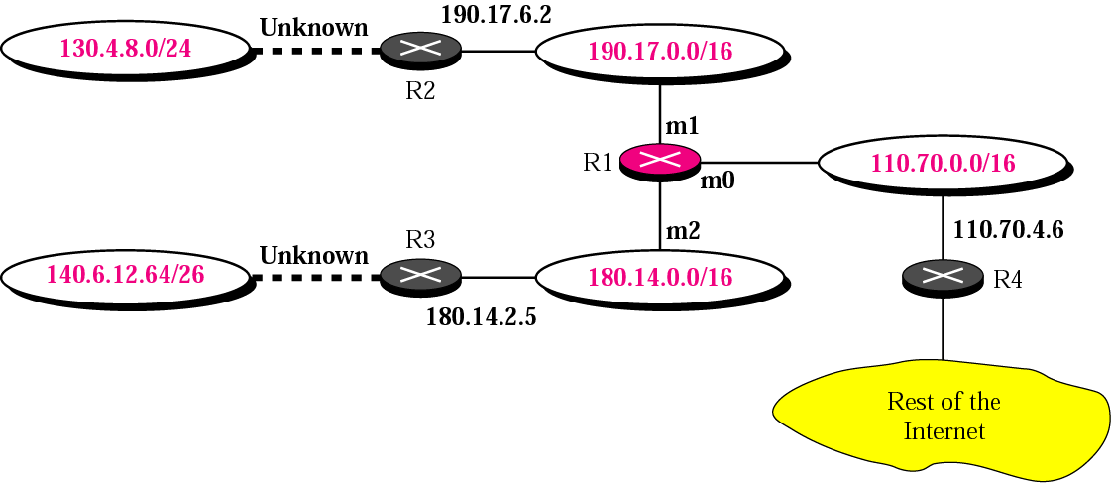
Figure 6.14 Guessed topology for Example 6

Slide 42
Address Aggregation
When we use classless addressing, it is likely that the number of routing table entries will increase.
This is because the intent of classless addressing is to divide up the whole address space into manageable blocks.
The increased size of the table results in an increase in the amount of time needed to search the table.
To alleviate the problem, the idea of address aggregation was designed.

Slide 43
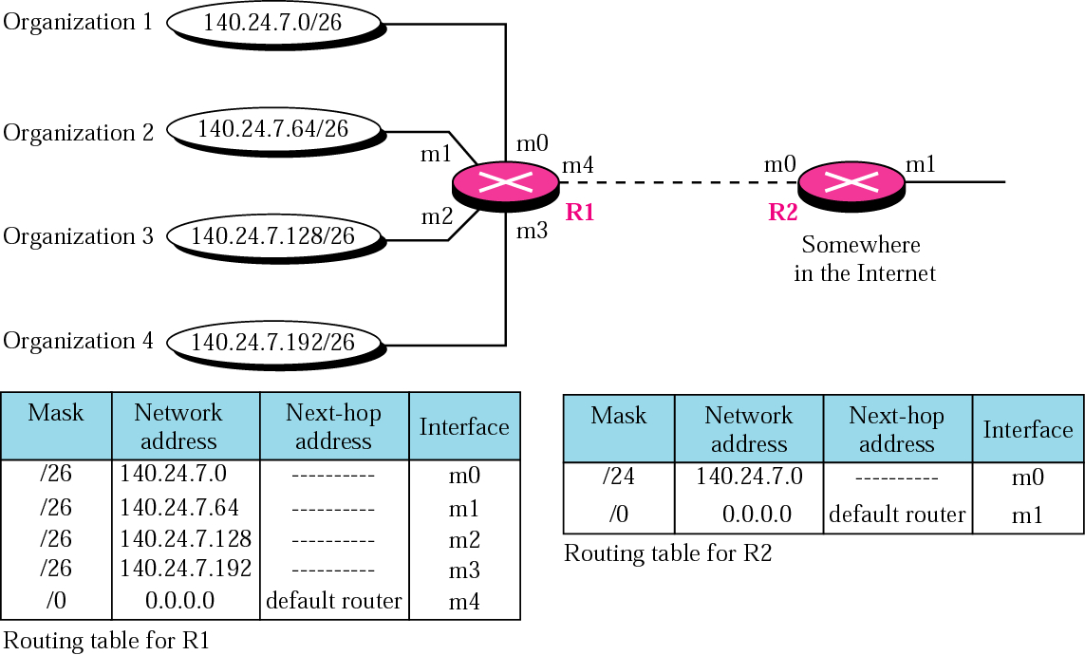
Figure 6.15 Address aggregation
i.e. 4 individual networks are aggregated into 1 single network with network address 140.24.7.0.
R2 would have a longer routing table if each organization had addresses that could not be aggregated into one block.
Notes:
Address Aggregation When we use classful addressing, there is only one entry in
the routing table for each site outside the organization. The entry defines the site even if
that site is subnetted. When a packet arrives at the router, the router checks the corresponding
entry and forwards the packet accordingly. When we use classless addressing,
it is likely that the number of routing table entries will increase. This is because the
intent of classless addressing is to divide up the whole address space into manageable
blocks. The increased size of the table results in an increase in the amount of time
needed to search the table. To alleviate the problem, the idea of address aggregation
was designed.
R2 would have a longer routing table if each organization had addresses that could not be aggregated into one block.
Note that although the idea of address aggregation is similar to the idea of subnetting,
we do not have a common site here; the network for each organization is independent.
140.24.7.0 ‭10001100‬. ‭00011000‬. 0000 0111. 0000 0000
140.24.7.64 10001100‬. ‭00011000‬. 0000 0111. 0100 0000
140.24.7.128 10001100‬. ‭00011000‬. 0000 0111. 1000 0000
140.24.7..192 10001100‬. ‭00011000‬. 0000 0111. 1100 0000
All 4 organization differ only in the last 8 bits, so 1st three Bytes( are common) can be used a network address to represent all four organizations.
i.e. 4 individual networks are aggregated into 1 single network.

Slide 44
140.24.7.0 ‭10001100‬. ‭00011000‬. 0000 0111. 0000 0000
140.24.7.64 10001100‬. ‭00011000‬. 0000 0111. 0100 0000
140.24.7.128 10001100‬. ‭00011000‬. 0000 0111. 1000 0000
140.24.7..192 10001100‬. ‭00011000‬. 0000 0111. 1100 0000
All 4 organization differ only in the last 8 bits, so 1st three Bytes( are common) can be used a network address to represent all four organizations.
i.e. 4 individual networks are aggregated into 1 single network with network address 140.24.7.0.

Slide 45
A router can reach four different organizations via the same interface. The IP prefixes used by the different organizations are 108.25.224.0/21, 108.25.232.0/21, 108.25.240.0/21 and 108.25.248.0/21
Can the router aggregate the prefixes? If so to what?
Answer Description
Binary value of the 3rd byte are as follows
224 -- 11100000
232 -- 11101000
240 -- 11110000
248 -- 11111000
The first 3 bits are same across all and this can be aggregated to 16+3 = 19 prefix
Hence the router can aggregate the prefixes to 108.25.224.0/19

Slide 46
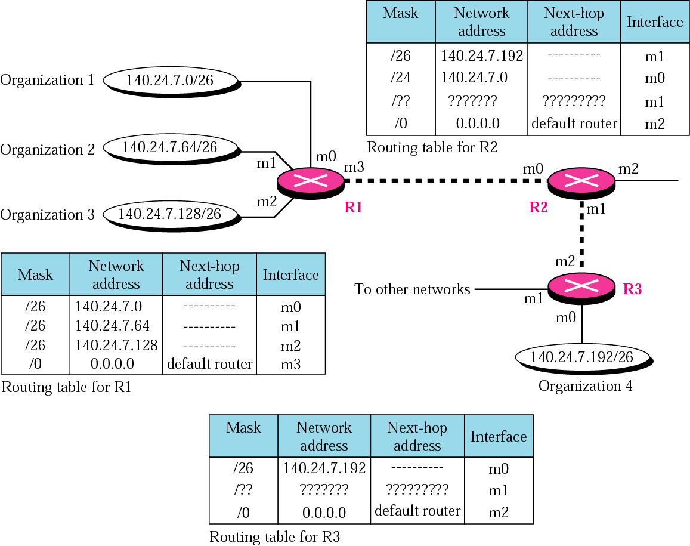
Figure 6.16 Longest mask matching
Destination IP is AND Longest mask first to get Network Address
Notes:
Suppose a packet arrives for organization 4 with destination address 140.24.7.200.
The first mask at router R2 is applied, which gives the network address 140.24.7.192.
The packet is routed correctly from interface m1 and reaches organization 4. If, however,
the routing table was not stored with the longest prefix first, applying the /24 mask
would result in the incorrect routing of the packet to router R1.

Slide 47
6.3 ROUTING
Routing deals with the issues of creating and maintaining routing tables.
The topics discussed in this section include:
Static Versus Dynamic Routing Tables
Routing Table

Slide 48
STRUCTURE OF A ROUTER
A router has four components:
input ports
output ports
Routing processor
switching fabric.

Slide 49
Input Ports
Bits are constructed from the received signal
Packet is decapsulated from the Frame
Errors are detected and corrected
Forwarded to Network Layer
Notes:
An input port performs the physical and data link layer functions of the router.
The bits are constructed from the received signal. The packet is decapsulated from the
frame. Errors are detected and corrected. The packet is ready to be forwarded by
the network layer. In addition to a physical layer processor and a data link processor,
the input port has buffers (queues) to hold the packets before they are directed to
the switching fabric.

Slide 50
Routing Processor
Performs the functions of the network layer
To find the address of the next hop and, the output port
Switching Fabrics
To move the packet from the input queue to the output queue
Ex: Crossbar Switch, Banyan Switch
Notes:
Routing Processor
The routing processor performs the functions of the network layer. The destination
address is used to find the address of the next hop and, at the same time, the output port
number from which the packet is sent out. This activity is sometimes referred to as
table lookup because the routing processor searches the routing table. In the newer
routers, this function of the routing processor is being moved to the input ports to facilitate
and expedite the process
Switching Fabrics
The most difficult task in a router is to move the packet from the input queue to the output
queue. The speed with which this is done affects the size of the input/output queue
and the overall delay in packet delivery. In the past, when a router was actually a dedicated
computer, the memory of the computer or a bus was used as the switching fabric.
The input port stored the packet in memory; the output port got the packet from the

Slide 51
Output Ports
same functions as the input port, but in the reverse order
outgoing packets are queued
packet is encapsulated in a frame
create the signal to be sent on the line
Notes:
Output Ports
An output port performs the same functions as the input port, but in the reverse order.
First the outgoing packets are queued, then the packet is encapsulated in a frame, and
finally the physical layer functions are applied to the frame to create the signal to be
sent on the line. Figure 6.24 shows a schematic diagram of an output port.
.

Slide 52
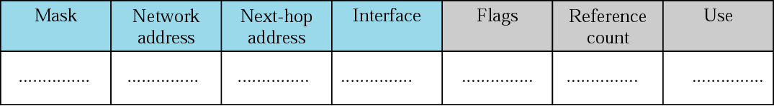
Figure 6.18 Common fields in a routing table

Slide 53
Flags
U (up): The U flag indicates the route is up and running.
G (Gateway): The G flag means that, the Route is to a gateway router rather than to a directly connected network or host the destination is in another network.
H (host-specific): Indicates the entry in the network address is a host specific address.
D(added by redirection): The D flag indicates that a new routing information for this destination has been added to the host routing table by a redirection message from ICMP.
Notes:
To view the Data ONTAP routing table, enter one of the following commands:
netstat -rn
route -s

Slide 54
M ( modified by redirection): The M flag indicates that the routing information for this destination has been modified by a redirection from ICMP.
Reference Count: the number of users that are using this route at the moment.
Use: Number of packets transmitted through this router for the corresponding destination.

Slide 55
END OF CHAPTER
Notes:
END OF CHAPTER

